Slide 1

English Viewing, Listening & Speaking
Communication and Culture
HU GUANGJIN
2025.2.--- 2025.6.

Slide 2

Course
Orientation
Target students: Non-English major, sophomore
Credit: 2

Slide 3
Communication and Culture
English Viewing, Listening & Speaking
Q1
This course is going to be about___________ ?

Slide 4
English Viewing, Listening & Speaking
Communication and Culture
S
Learn to communicate
by way of
viewing
listening
speaking
About Culture
Q2:
What is CULTURE?
e

Slide 5
Q2: What is CULTURE?
Example
Definition
Understanding

Slide 6



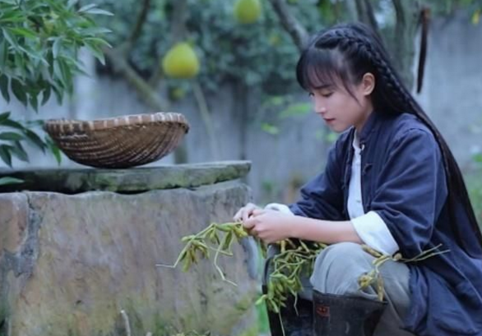
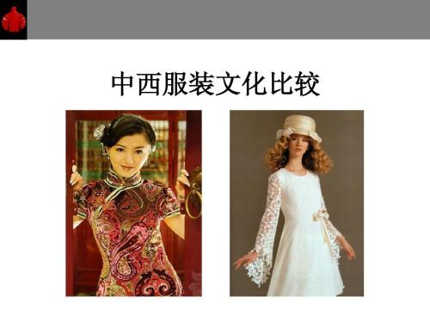
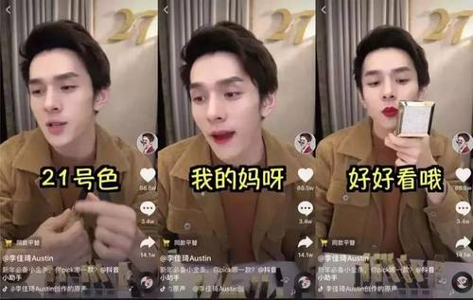

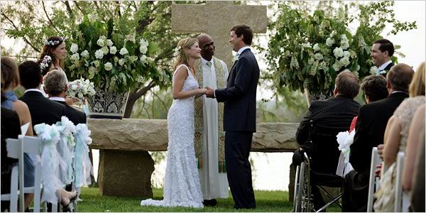
Carrier & embodiment
Way of doing things and its outcome: observable & tangible

Slide 7
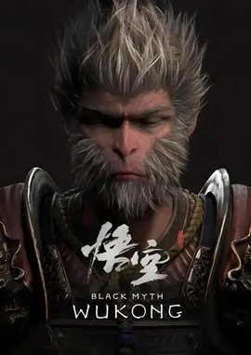
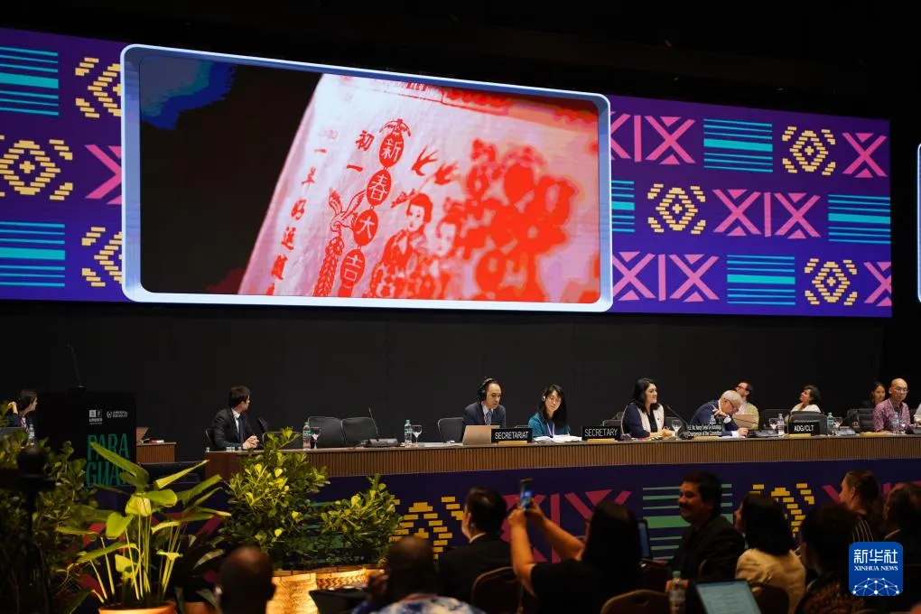

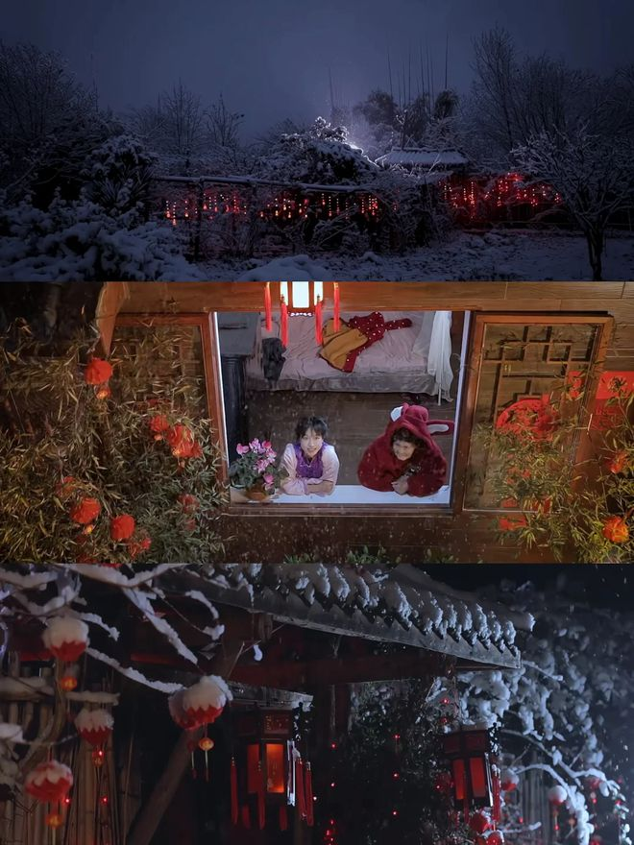
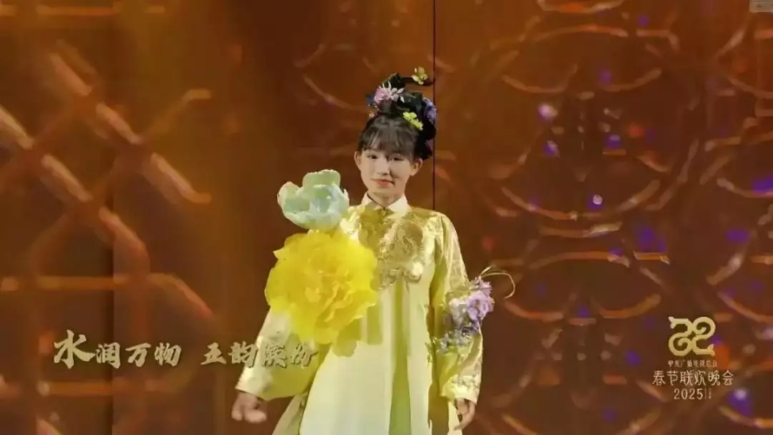
Carrier & embodiment
Way of doing things and its outcome: observable & tangible

Slide 8
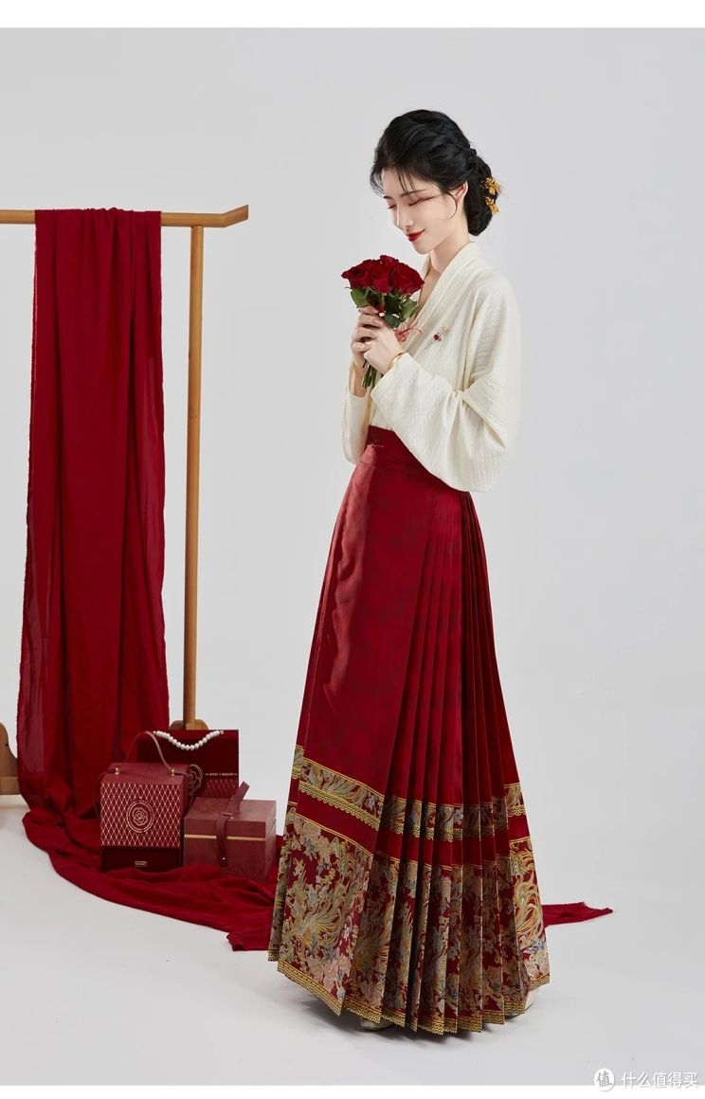
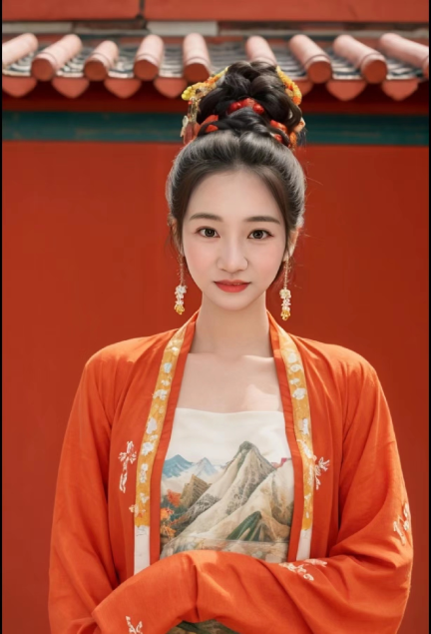
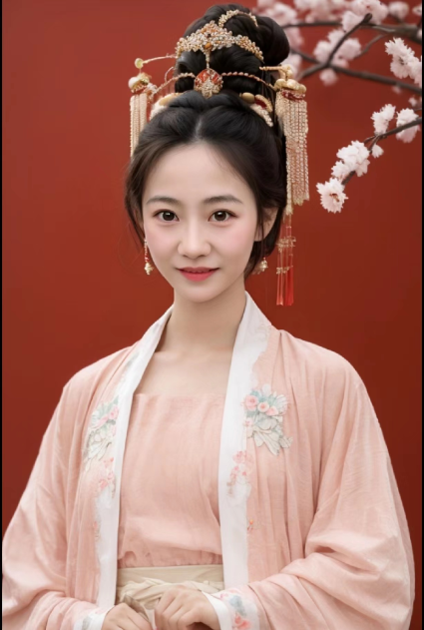
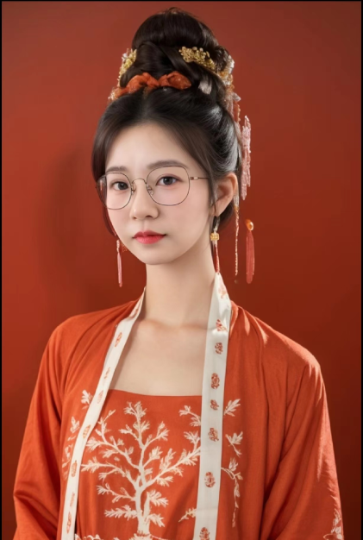
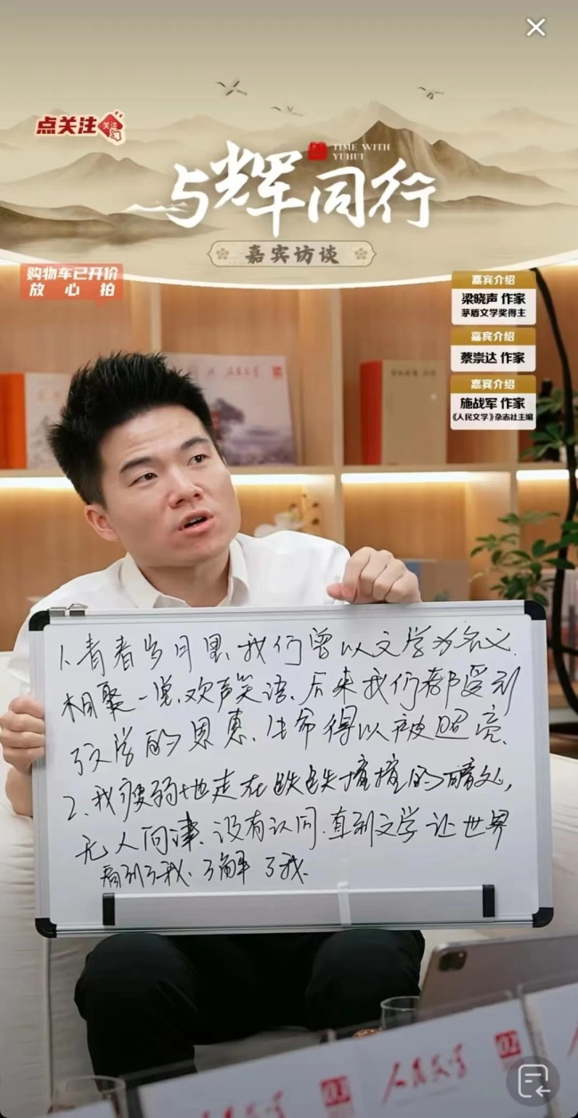
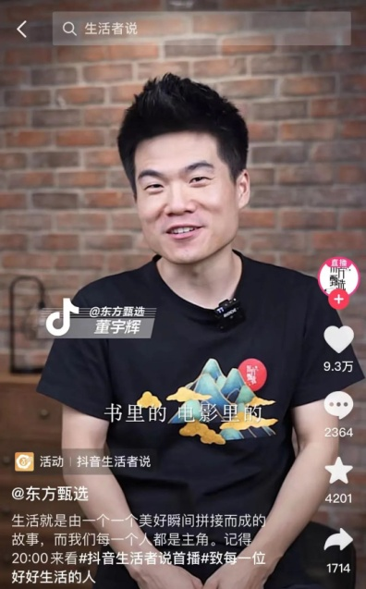
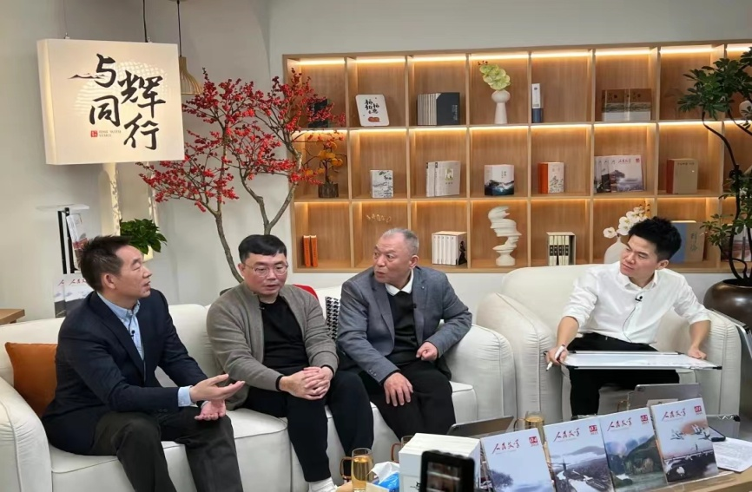
Carrier & embodiment
Way of doing things and its outcome: observable & tangible

Slide 9
what
What is culture？
Culture is a complex, which “involves knowledge, belief, art, morals, law, customs and any other capabilities and habits acquired by man as a member of society”. (English anthropologist Edward B. Tylor)
Culture is the sum of all the forms of art, of love and of thought, which, in the course of centuries, have enabled man to be less enslaved. (French novelist and critist Andre Malraux)
Culture is a system of shared beliefs, values, customs, behaviors, and artifacts that the members of a society use to cope with their world and with one another, and that are transmitted from generation to generation through learning. (American scholors Danial Bates and Fred Plog)
which, int eh S

Slide 10
what
What is culture？
which, int eh S
文，“错画也，象交文”。（《说文解字》：各色交错的纹理、纹饰，各种象征图案，包括语言文字、文物典章礼仪制度等。）
关乎天文，以察时变，关乎人文，以化成天下。（《周易》）
“文”与“化”在汉代以后结合成“文化”一词，意为以“人文”来“化成天下”。
文化是一个社会中所有与社会生活相关的符号活动的总集合。（赵毅衡）

Slide 11
Culture
diversify: v. 多样化
Definitions of culture DIVERSIFY.
Different definitions highlight different aspects
Some even conflict with each other
Let’s give it a shot:
Course understanding about culture

Slide 12
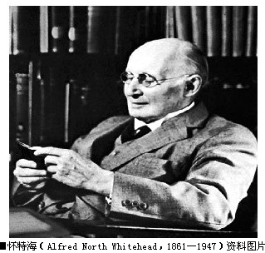
Culture
Definition:
（1）a way of doing things (behaviors/customs/ products/ phenomena)
（2）a way of thinking
(values and beliefs regarding the world, human beings and concerning what is right ,what is important, or what is the most desirable )

Slide 13

Case Study 1
carp：n 鲤鱼
lotus：n 莲花
subtle： a.含蓄的
New year wish:
traditional Chinese way
lotus + carp
homophony (同音异义）
年年有余
having surplus in the new year
a word game
an indirect/subtle way

Slide 14

New year wish:
American way
clearly written on the card
in a direct way and in clear language

Slide 15


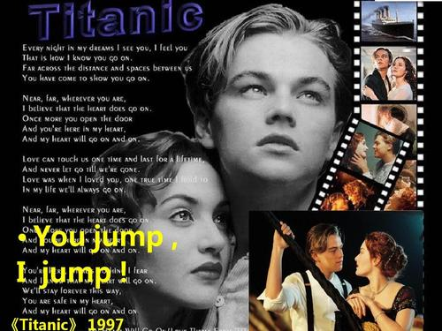
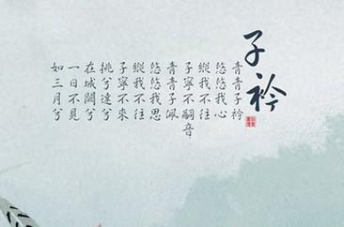


word game
clear writing
Chinese ways for feeling expression and art creation :
Indirect/implied/, euphemism/fancy
Western ways for feeling expression and art creation:
direct /explicit , rich /strong
Thoughts/values about world and human differ

Slide 16

Culture:
Two parts of the iceberg:
Way of doing things
Way of thinking
( by education and socialization)

Slide 17
Culture
Behaviors/customs/phenomena
(行为层面)
carrier & embodiment of culture (文化的载体与外显)
The value /belief system
(观念层面)
core & foundation of culture (文化的内核与根基)

Slide 18

How to communicate about culture in this course
I see and Identify
What are these cultural behaviors/phenomena
Compare and contrast
How are these cultural behaviors/phenomena different across cultures?
Explore and Explain
Why are there such differences?

Slide 19
Case study 2
My American landlady was over 70, and we got along very well.
One day, when we were ascending the stairs together, I stretched out my hands to give her some help.
At the sight of my gesture, she said: “ I can do it, thank you.”
I thought she was just being polite, so I escorted her to the top of the stairs.
On the way up, she did not utter a word, her facial expression hinting that she did not appreciate my kindness.
escort: v. 陪同：v

Slide 20
Case study
After pausing a minute or two, she continued her way up alone.
Not being aware of my improper “over-kindness”, I practiced “Leifeng” once again.
This time, half-jokingly and half seriously, my landlady turned to me and said : “Young man, do you think I am old and useless? When I have to move myself on a wheelchair, I’ll ask you for help.”

Slide 21
Case study: Analysis
Identify the behaviors
Q1：What has this Chinese student done to his American landlady ?
Q2: What was the response of this American lady?
Compare and contrast the behaviors across culture
Q3： How do we Chinese people evaluate the behavior of this
Chinese student ?
Q4：Gathering from the American lady’s response, how do they
evaluate this behavior?

Slide 22
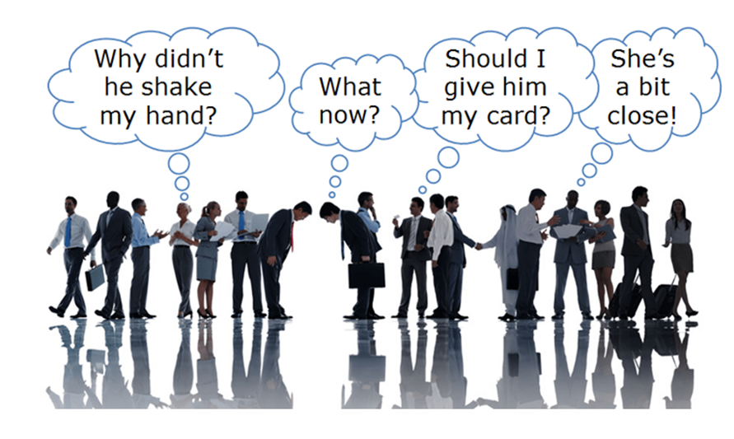
Case study: Analysis
Provide explanations to the different behaviors as they are
Q5： Can you give any reason explaining these different responses
to this Chinese student behavior?

Slide 23
Case study：Reasons behind -Value/ belief
According to Chinese cultural values :
Being old in Chinese culture symbolizes________
Mentally experienced and wiser
Physically weak
deserves respect and extra care
Enjoy being treated with extra care and respect
Chinese students’ offer of help = expressing his care and respect
a proper behavior worthy of praise and advocation

Slide 24
Case study：Reasons behind -Value/ belief
According to American cultural values
Being old in American culture symbolizes________
Mentally especially physically weak and feeble
Lack of masculinary (阳刚的，充满男子气概的) power
being useless
are not willing to be regarded
Reluctant to admit
Chinese students’ offer of help =taking the lady as “being old”, and “being useless”
Be offending
Be refused and declined

Slide 25

Case study: A full understanding of culture
Behaviors:
Chinese student: offering help
American landlady: declining the help
Value/ belief:
Different evaluations of “being old”.

Slide 26

Theory-learning (case-based generalization)
The problem of both people: They tend to ?
Cultural barrier leading to the failure of cross-cultural communication：
Assuming similarities instead of differences
The tendency of interpreting and judging the other cultural behaviors/ phenomena from the norms of one’s own culture
( Refer to Micro-lecture Unit 4 )

Slide 27
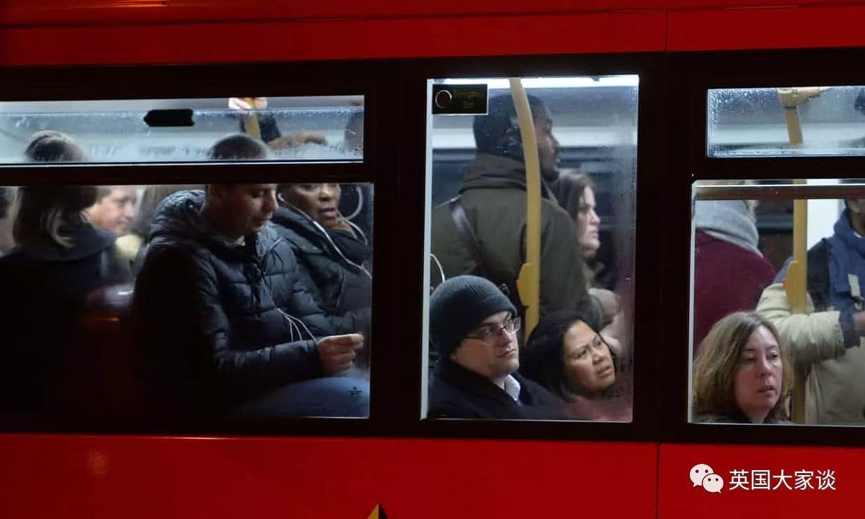

Aims of this course (1) : Cultural competence
Strengthen sensitivity to cultural behaviors/ phenomena
(avoid being ignorant and shallow)
Cultivate cultural awareness in cross-cultural communication
(avoid being misinterpreting and prejudiced)

Slide 28
Communication ability
Aims of this course (2)
Substance （借着文化的丰富性， 拓宽交流的广度）
Inclusiveness (借着文化的异质性， 培养交流的包容度)
Depth (借着原因的探索与挖掘， 增加交流的深度）

Slide 29
Better speaker
of English
More tactful communicator
A person of culture competence
in cross-cultural communication

Slide 30



Session 4:
文化理论升华
文化态度养成
Session 3:
文化原因深挖
Session 2:
文化差异比较
Session 1:
文化现象初探

Slide 31
Schedule
Week 16:
Listening & reading Test
Week 18:
Final Test
Week 1-15:
4 Topics
Week 17:
Q & A

Slide 32

Course management
课堂
学习通（超星）自学微课/UNIPUS课程资料
  https://i.mooc.chaoxing.com/space/index?t=1708932290513
  https://umoocs.unipus.cn/course/4125
QQ群：上课参与与记录，提交录音作业。
小组：自建小组QQ群，完成小组项目。

Slide 33
Course Evaluation
1. 形成性成绩 (50%) ：
个人 （30 分）：
两次课堂考试（5+5=10分）+课后录音（10分）+ 微课（笔记/测试5分）+
课堂表现（5分，课堂发言和DC任务等）
小组 （20 分）：
两个项目（20分， Project1: PPT10分+ Project 2: Micro-video10分 ）
2. 终结性成绩 (50%) ：水平测试，年级统一, 难度相当于六级考试

Slide 34
学习通（超星）自学微课
  https://i.mooc.chaoxing.com/space/index?t=1708932290513
  个数+进度（总分40分），截止 6月8日
  36以上 不扣分
  25—36分 -0.5分
  11—24 分 -1分
  0—10分 -1.5分
  从未登陆 -2分

Slide 35
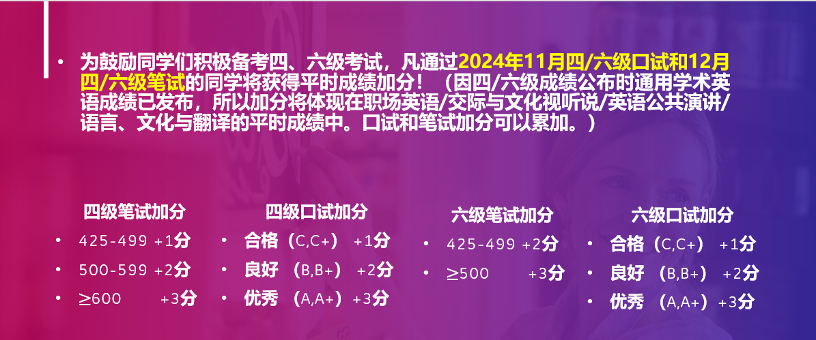

Slide 36
Reminder：关于价值观在文化中的处境与作用，不能忽略以下几个points:
核心原因 V.S. 并非唯一原因
相对稳定性 V.S. 并非固定不变
作为主流的values of cultural group V.S. values of individuals 或 values of the culture within culture
价值观的对立与碰撞 V.S 普世价值观上的一致
后天价值观的形成 V.S 先天人性的特点

Slide 37


Thank you

